Slide 1


Earth2.io Data Breach
Research by:
TheRedBeardGuy

Slide 2

INTRODUCTION
A significant data breach occurred within the Earth 2 platform, affecting 420,961 accounts. The compromised data primarily involved email addresses and usernames linked to the Virtual Earth game.
The breach occurred on October 16 and was added to the breach notification service Have I Been Pwned (HIBP) database on November 7, 2024, providing an opportunity for users to check their exposure.
While the breach exposed player usernames and email addresses, it is essential to note that no sensitive personal information, such as passwords or financial data, was affected.

Slide 3

Description of the Attack
Type of the attack: Data Breach
Date and location: October 16
Entities involved: Gravatar, Earth2.io, Global
Aim of the attack: The exposure of user email addresses. This was a technical oversight rather than a malicious attack.
Technical Details
The integration of Gravatar into the Earth 2 platform, without proper security measures, led to the exposure of user email addresses. This was a technical oversight rather than a malicious attack.
Key elements:
Vulnerability exploited: Earth 2's breach stemmed from Gravatar, which presents links to avatars as MD5 hashes in consuming services.

Slide 4
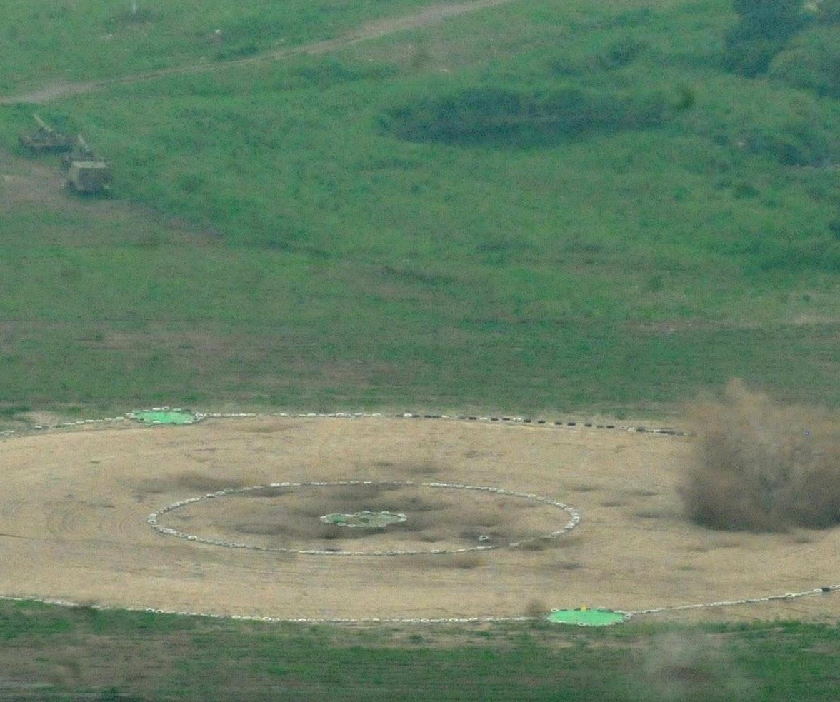
Impact of the Attack
Immediate impact: The breach exposed players usernames and email addresses of the Gravatar accounts.
Long-term impact: The attack paved the way for changes in cybersecurity policies and practices but it has also made a lot of user’s lose faith in the company.
Preventative measures could have included:
Regular software updates and patch management, particularly for critical vulnerabilities.
Increased focus on cybersecurity awareness and training.
Incident Response: The company took immediate action, disabling the feature that allowed this exposure.
Removing the exploited vulnerability.
Enhancing security protocols.

Slide 5

Lessons Learned
Key takeaways include the importance of regular system updates, penetration testing of the system and better training.
Users Takeaway
Use an email mask, Use unique, strong passwords for every account, Put your login details in a secure place only you can access, such as a password manager, Updating your smartphone apps, browsers, and operating systems makes your devices more secure, If you are asked to enter or give out your email address, ZIP code, or phone number, you can say no.
References
[1] pkware.com/Earth2-data-breach
[2] https://monitor.mozilla.org/breach-details/Earth2
[3]technadu.com/earth-2

